Slide 1
From Data to Knowledge
M. Weiss, R. Schaefer, L. Paxton, C. Pikas, S. Babin, S. Simpkins, D. Morrison, J. Holm*, B. Fortner*
NASA/JPL, Pasadena, CA
NC State University, Raleigh NC

Slide 2
Outline
Current Problems: Climate Change & Space Weather – critical Earth and Space Science areas
Need more than data (through e.g. VxOs) to address problems
Data must be translated into knowledge -> “actionable” information for decision makers
Elements of the solution: Data & model access, Collaborative workspace, subject matter expertise, knowledge management, active subgroups
=> The Process can be efficiently aided through the establishment of Virtual Organizations
APL work toward VOs
Note: In this talk VxO = Virtual “x” Observatory; VO = Virtual Organization
Notes:
APL is creating a generalizable and extensible architecture approach to transform data into knowledge and provide the glue to connect existing resources to create a Virtual Organization. It is focused on creating a collaborative discovery environment that enables knowledge access and information transformation. APL is using this architecture to support two different problem spaces – space weather science and applications with SWIFTER-ACTION, and earth sciences to address climate and weather impacts with GAIA. A Virtual Organization enhances discovery and innovation by bringing people and resources together across institutional, geographic and cultural boundaries. APLs virtual organization will enable new opportunities but builds on existing skills and capabilities to create new core areas of competency that will enable discovery and decision making at all levels of our technological society and will provide the communication tools to connect researchers and users that will transform the fractionated space science community into a virtual organization. We will build this new culture by enabling the users to close the loop with the basic research community in a ready and organic manner.

Slide 3
The Problem
The world is facing problems of a global scale that are very challenging:
Space Weather events can disrupt our increasingly high tech dependent society
Climate Change effects threaten lives, societies, and political stability
These problems require coordinated action from a variety of agencies and institutions by people who are not experts in space weather or climate change.
A wealth of data and models exist that can be analyzed by experts to translate the data and model results into knowledge.
Bringing together data and models through a unified interface is not enough; we must bring together the community: data providers, subject matter experts; scientists, policy analysts, etc. into a virtual organization to get the appropriate knowledge to the people who need it.

Slide 4
Disparate Communities – Wide Ranging consequences
Agencies: NASA, NOAA, FAA
Commercial Air, Ground
Military
Space Weather: Common Needs
Utilities
Internet,
Power
Homeland Security
Public
Scientific research
Education
Notes:
Cultural divide in organizations that use the information

Slide 5
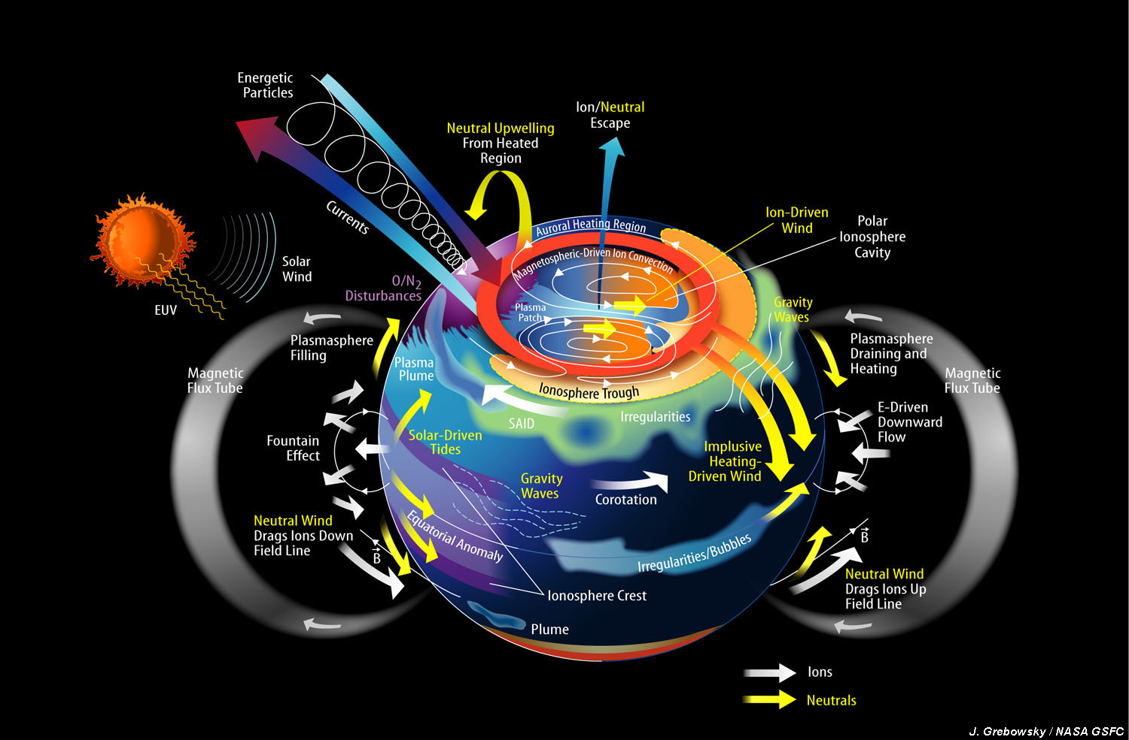
Space Weather Crosses Scientific Disciplines
Solar Energetic Particles
Solar Effects
Magnetospheric Effects
Lower Atmospheric Effects

Slide 6
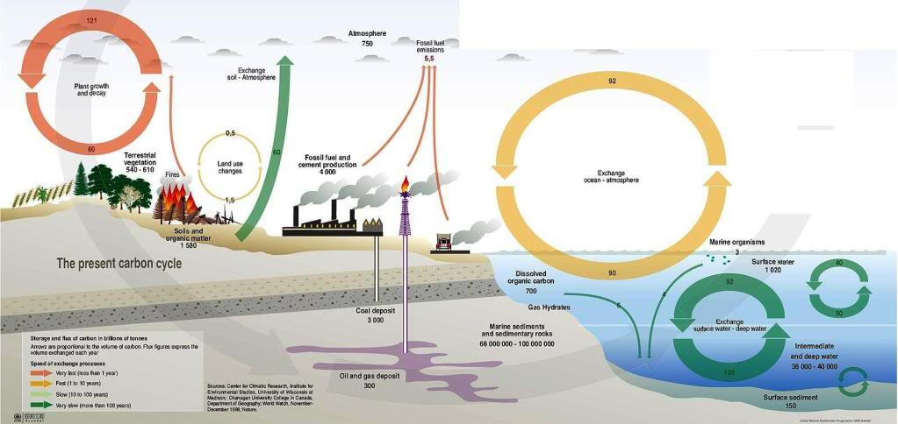
Understanding Climate Change Similarly mixes Earth Science Disciplines

Slide 7
Climate Change Consequences Are Wide Ranging, Serious, and Urgent
Current CO₂ emission rate higher than IPCC “worst case” scenario
Billions of People would experience serious consequences from climate change
Relative vulnerability of coastal deltas as shown by the indicative population potentially displaced by current sea-level trends to 2050 (Extreme = >1 million; High = 1 million to 50,000; Medium = 50,000 to 5,000; following Ericson et al., 2006). Source: IPCC
UNEP Climate Change Science Compendium
Governments and Organizations need to re-orient policies and procedures to prepare for this eventuality

Slide 8
But Tools for decision makers are fractionated and deciders are isolated within their communities
Legal Requirements
Watershed Models
Wastewater management
Education
Economic planning
Economic Models
Recreational Use
Climate Models
Traffic management
Water quality measurements
Public Health
NGOs
Fisheries Productivity and Management
Agricultural Productivity
Commercial Sector
Weather
Research
Air Quality
Public Sector

Slide 9
How to Work toward Solving These Problems
Goal: Bring together stakeholders, data providers, researchers, scientists, and policy analysts together in a virtual organization to transform data and models results into knowledge
Two virtual organization concepts being developed at JHU/APL
GAIA – Global Assimilation of Information for Action (Climate Change VO)
SWIFTER - Space Weather Informatics, Forecasting, Technology, and Enabling Research (Space Weather VO).
Bring together the elements and people necessary for the VOs
Collaboration and Data Discovery Tools
Social Organization of Communities

Slide 10
Ingredients for SWIFTER & GAIA VOs
Social Collaboration Tools
Data Access – satellite data, model results, climate records, ground data (a diverse set including economic and agricultural data for climate change)
Data Manipulation tools – to enable discovery, need general search and visualization capability
Social Collaboration Tools – for knowledge sharing and management (wikis, blogs, workflow sharing, user rating of data sources, etc.)
Social Organization
Organize active subgroups on focused topics
Conduct a series of focused workshops & seminars
On-line forums moderated by identified subject matter experts
Social scientists to identify governance issues

Slide 11
SWIFTER VO elements
Tools for SWIFTER already available at APL that can be incorporated:
VITMO – Virtual Ionosphere Thermosphere Magnetosphere Observatory – data and graphic visualization of a range of data
SuperDARN, SuperMag, Distributed Advanced Radar Network and global magnetometer data aggregations visualizable with a common framework (rBrowse)
Experience bringing Research tools into Operational use (R2O)
Ionospheric Satellite Sensor Teams (TIMED and DMSP UV sensors)
Blackbook3 data fusion backbone
E-conferencing capability (http://workshops.jhuapl.edu/s1/index.html)
Subject matter experts (space weather research faculty)
Regular Space Weather Meetings (including APL “SEASONS” Space Weather conference)

Slide 12
GAIA VO
APL Team identified: Analysts, Scientists, Information Technologists, Information Managers, and Social Scientists.
APL Establishing Partnerships with other organizations:
Johns Hopkins Environment, Sustainability, and Health Institute
JHU Department of Earth and Planetary Sciences
Center for Integrative Environmental Research, U. MD
NOAA Climate Program Office
In the planning stage for a series of focused workshops on specific climate change issues to identify the highest priority issues.
Build on experience from VITMO data aggregation and other space weather data discovery tools.

Slide 13
GAIA and SWIFTER Focus
Bringing together the community from its disparate organizations
Enabling the community to collaborate and share knowledge
Guiding the community to identify its high priority issues, metrics, and its own best solutions.
SWIFTER – identifies best data/models based information to make decisions about Space Weather vulnerable technologies
GAIA – gathers information about specific climate change issues to enable policy makers to understand the coming consequences

Slide 14
Summary
Difficult problems facing society
Heavy dependence on Space Weather vulnerable technology as we approach the maximum solar activity period after a long quiet period
Climate Change will impact the world in ways that will change societies in potentially catastrophic ways – we need to start making policies that mitigate those effects now.
APL working to create VOs to address these areas:
SWIFTER – Space Weather
GAIA – Climate Change Impacts
Both will be enabled by Collaborative web based knowledge sharing /management tools.

Slide 15
Backup

Slide 16
How to Enable Decision Makers With Actionable Information
Climate Change Needs: “The federal government should undertake a national initiative for climate-related decision support.... This initiative should include a service element to support and catalyze processes to inform climate-related decisions and a research element to develop the science of climate response to inform climate-related decisions and to promote systematic improvement of decision support processes and products in all relevant sectors of U.S. society and, indeed, around the world.” – NRC, “Informing decisions in a changing climate” NAS Press.
Space Weather – The explosion in the use of Space Weather vulnerable technology (e.g. GPS, satellite communications, unregulated power grids, etc.) requires a better flow of actionable information so
Create VO to bring together data providers, analysis tools, subject matter experts, and policy makers together in a collaborative, discovery enabled environment.
SWIFTER & GAIA

Slide 17
Research to Operations (R2O)
Difficulty transitioning a research product to a reliable operational product “crossing the valley of death” (see http://www.nap.edu/catalog/9948.html) requires:
Understanding the importance and risks of the transition
Continuous development of the transition plans
Adequate resources
Continuous feedback (in both directions) between the R&D and operational activities; feedback between organizations is especially difficult to facilitate
Difficult enough within a single institution – here, we have to cross institutional and “cultural” boundaries (commercial, military, academic, governmental) where users and researchers do their work
Here, cultural refers to the social organization of an institution.

Slide 18
Knowledge Management Needs – Space Weather
Raise awareness of all available nowcast & forecast products/procedures
Capturing the best products and methods to meet specific needs (best practices)
Come to consensus on a uniform set of metrics (e. g., skill scores) to judge quality of forecasting/nowcasting techniques
Come to consensus on the type and number of sensors needed for reliable space weather forecasts
Collect dispersed expertise into an easily accessible place
Provide help to make space weather related data (e.g. from VITMO) and models (e.g. from CCMC) more easily accessible to non-expert users
Provide a forum for communicating new developments in Space Weather forecasting

Slide 19
Knowledge Management Needs – Earth Sciences /Climate Change
Raise awareness of all available nowcast & forecast products/procedures
Capturing the best products and methods to meet specific needs (best practices)
Come to consensus on a uniform set of metrics (e. g., skill scores) to judge quality of forecasting/monitoring techniques
Come to consensus on the type and number of sensors needed for reliable space weather forecasts
Collect dispersed expertise into an easily accessible place

Slide 20
Outreach Needs
Increase public awareness of modern society’s dependence on space and the need for space weather.
Provide a forum for the public to learn more about space weather
Educate public and policy makers about issues, events, and consequences of space weather and space weather information dissemination
Provide a translation between the needs of users and the capabilities and methods of current and future space weather technologies – why should anyone change what they’re doing now?

Slide 21
How to Address These Needs?
Follow the internet paradigm for knowledge management!
Build a Virtual Organization :
Establish an On-line Community of Users
Provide on-line tools to foster information sharing:
On-line forums
Bulletin boards
Focused tutorials
Virtual meeting rooms
On-demand data visualization
Users ratings of products
Moderator Tools to focus, summarize, and enable discussions
Facilitate user communication about products and methods
Become a portal for multiple data sources and models
Build with the intention of growing rather than relying on a priori definition

Slide 22
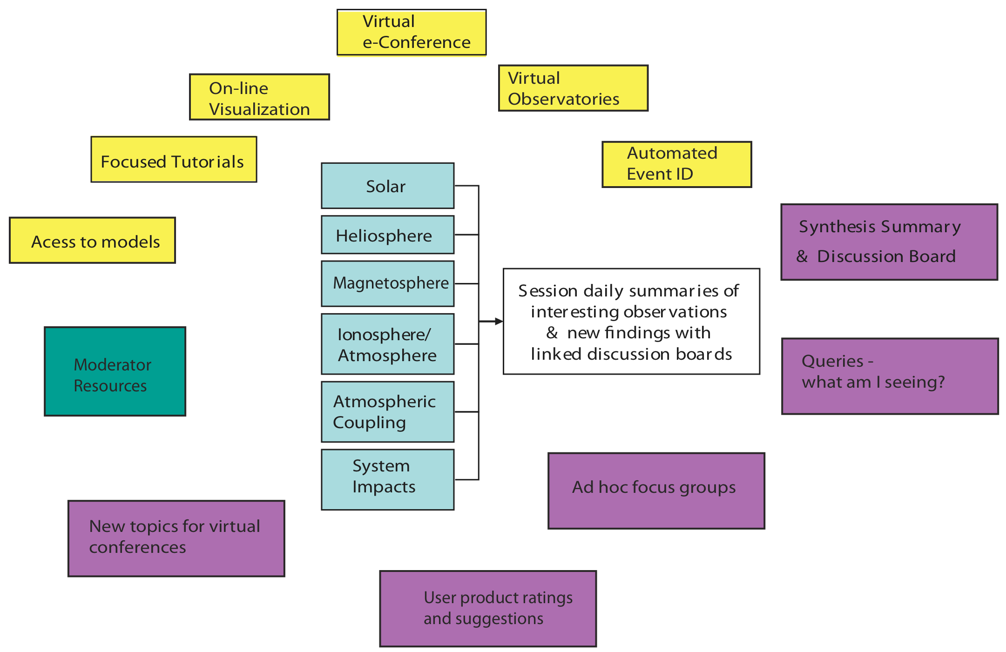
A Variety of Internet Resources will be enlisted.
Tools must be provided to foster cross disciplinary discussions

Slide 23
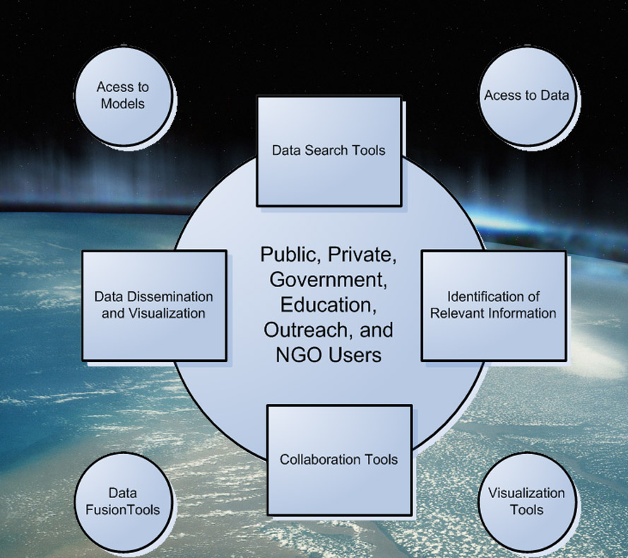
What is the need that our VOrg fills?
Provides the glue to connect existing resources to create a Virtual Organization that connects users with knowledge and subject matter experts.
Addresses needs that are unmet by current systems by integrating climate and weather models into a decision support framework.
Users and analysts will be connected through GAIA & SWIFTER.
A key technology need for our community is the establishment of a Virtual Organization

Slide 24
Earth Sciences Needs a “Systems Integrator”
GAIA is a generalized open architecture designed to support cross-cutting decision making
Vision: “enabling decisions – getting the right information to the right people right in time”
Access to global climate change data is a challenge for US government, non-government organizations, and researchers alike.
Climate change and its impacts are no longer purely a “science” problem
Data are distributed across many government organizations in a wide variety of formats
Not all data are readily accessible to users because of formats
Not all data are known to users who should have access
Data may be available – but actionable knowledge may not
The data are “designed” to meet the needs of the particular science community that created that data set

Slide 25
GAIA – “One stop shopping for Earth Science Knowledge and Information”
In the following slides the functional requirements of GAIA are described.
Analysts can be thought of as members of the basic and applied research community
Users are government and NGO policy makers as well as members of the research community.
GAIA enables the transition of models and information from research to operations.
GAIA enables decision making.
GAIA institutes 3 core elements:
A data access function – GAIA VxO
An interaction e-connectivity facility – e-GAIA
An interactive visualization library – GAIA ACTION

Slide 26
The GAIA VxO unites a variety of data types through a common interface.
The data are held remotely – not at the Virtual Observatory (VxO)
We build on existing efforts by others
What we provide is the glue to connect the user to the data
We provide the service that allows a novice or skilled user to locate data of interest.
There are no Earth Sciences Virtual Observatories – because of this:
Every user has to discover the relevant data for themselves
Each user has to determine how to handle the data files
Each user has to develop procedures to open the data files
Each user has to determine how to visualize the data
GAIA will a solution for a small, high value focus-area – food security with the test case being the Chesapeake Bay
GAIA will provide the means to access and preview data as well as to select and download data for local use
GAIA will enable comparisons between data and models
GAIA will answer:
Where are the data?
How are they accessed?
What format are they in?
What do they mean?
How good are the data?

Slide 27
Analyst
Data Access Across VxOs
One stop shopping through a simple interface
Virtual Observatory –
the glue that enables
connection to the data
Geophysical Data (topography, geology, land use, surface composition)
Model output and forecasts
Sensor(s) data
Experiment planning tools and coincidence calculators for space and aircraft
Sensor(s) information (incl. availability, location, band coverage, resolution, limiting sensitivity, accuracy)

Slide 28
Work flow – capturing the transformation of data into knowledge
Knowledge transfer as well as information content is the goal
Once a tool for producing a given data product has been created - how do you reproduce that?
“Workflow” means reproducing the process of achieving a given result:
What data were accessed?
What parameters were supplied?
How was the data processed?
Where are “golden data sets” produced with this flow?
A workflow can be passed on to a user - RtoO
The user can then reproduce the processing of a highly skilled analyst.
The workflow can become an algorithm that supports a user directly.

Slide 29
GAIA/SWIFTER will leverage APL and IT community investments
APL has a rudimentary infrastructure that can be pieced together to support collaboration: (http://workshops.jhuapl.edu/s1/, wikis, sharepoint, meetingplace, etc.) but they are not integrated.
Collaborative platforms which provide the means to share information:
Hubzero, Drupal, and Blackbook.
Blackbook supports tiered, secure access to data
For many users this will be an important factor in any collaborative environment
Supported by US National Intelligence Office
Blackbook wiki at http://blackbook.jhuapl.edu
These applications support “work flow” extensions
Work flows are the means for capturing subject matter expert knowledge as a “process” that is repeatable and adaptable
The e-GAIA facility enables the users to close the loop with the analysts.

Slide 30
APL Well Positioned to be Home Institution for Space Weather Virtual Organization (SWIFTER)
Space Weather data: build on VITMO (Virtual Ionosphere Thermosphere Mesosphere Observatory), SuperMAG, and a variety of home grown Space Weather products and visualization tools to expand data access and usage
APL already works with a variety of organizations (NASA, Military, Homeland Security, University (JHU), etc.
Leverage Knowledge Management expertise with APL partner NASA/JPL
Already provides virtual meeting facilities (used for CAWSES)
APL has facilities for classified meetings to meet DoD needs
APL has in-house space weather expertise in solar physics, magnetospheric dynamics, and aeronomy who are part of teams for ACE, TIMED, AMPERE, STEREO, RBSP and other well as other sensors UV imagers, in-situ particle detectors.

Slide 31
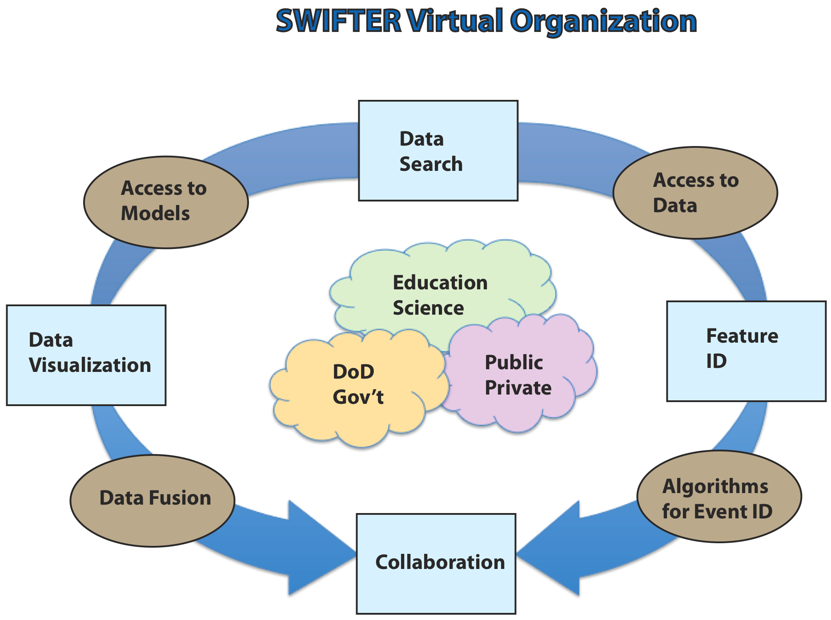
SWIFTER Summary
Space Weather: common needs from disparate communities
Progress can be facilitated with the creation of a Space Weather Virtual Organization (SWIFTER)
Brings together a set of tools to access data, models, and on-line collaboration tools to enable rapid progress

Slide 32
APL can provide a unique approach to addressing Earth Science issues
APL plays a key role as a technical resource for all US government agencies.
APL has the vision to support the assessment of climate and weather impacts on issues of importance to the US and its interests
Climate has impacts across the spectrum from the economy to defense and international and national issues.
The problem is that the approaches, to date, to climate impacts have been fragmented even within a given agency.
GAIA will demonstrate a generalizable approach to transforming data into knowledge
GAIA will do this by picking a well defined test case and delineating an architecture that will address Earth Science issues within that test case.
The environment defined by GAIA can be applied to other problems.

Slide 33
GAIA – enabling decisions through information access
GAIA is a generalized open architecture to support cross-cutting decision making
Vision: “enabling decisions – getting the right information to the right people right in time”
Access to global climate change data is a challenge for US government, non-government organizations, and researchers alike.
Data are distributed across many government organizations in a wide variety of formats
Not all data are readily accessible
Not all data are know to users who should have access
Data may be available – but actionable knowledge may not
GAIA will address a “test case” – food security that addresses needs across APL stakeholders and ties in other areas in JHU
School of Public Health; The Paul H. Nitze School of Advanced International Studies; Carey Business School
All APL Business Areas are touched by the test case.

Slide 34
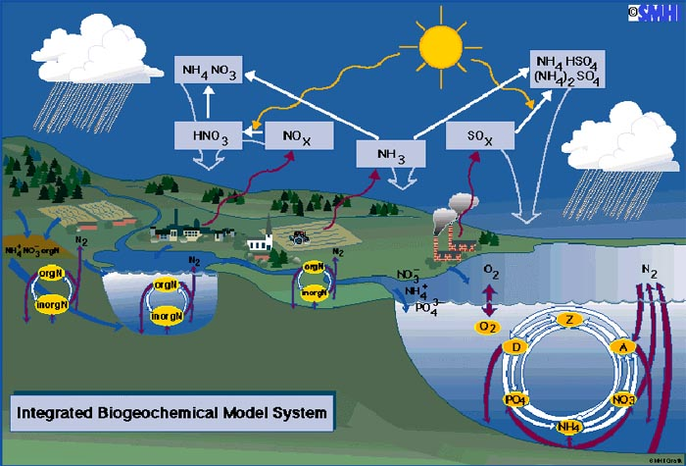
The Nitrogen Cycle Couples Climate, Weather and Human Activity
There is a large modeling community that is decoupled from policy makers.
The models don’t speak to the public.
What does increased dissolved NH4 mean to a fisherman?

Slide 35
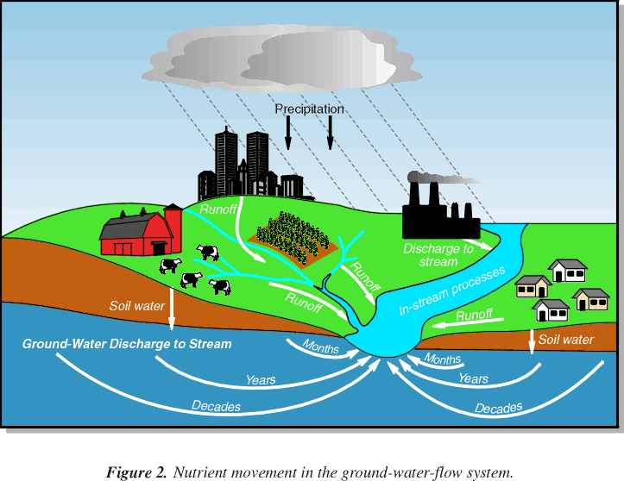
Users may be concerned with short to long term timescale effects and responses
Planners (urban, county, road, waste water) intersect with commercial users and government agencies.
Complexity can obscure the inter-relationships between the various communities making informed decisions difficult.
Notes:
http://md.water.usgs.gov/publications/fs-150-99/html/index.htm

Slide 36
Groundwater issues illustrate some of the concerns
Groundwater contributes more than half (54 percent) of the total annual flow of streams in the Chesapeake Bay watershed.
The Groundwater nitrate load contributes about half (48 percent) of the total annual nitrogen load of streams entering the Bay.
The apparent ages (residence times) of water collected from springs range from modern (0-4 years) to more than 50 years, with 75 percent of the ages less than 10 years.
The discharge, nitrate load, and residence time of Groundwater vary in the watershed due to differences in combinations of rock type and physiographic province (known as hydrogeomorphic regions), and land use.
Quantifying the discharge, nitrate load, and residence time of Groundwater in the Chesapeake Bay watershed assists in developing an understanding of the movement of nutrients from their sources to streams, and in determining the "lag time" between the implementation of management actions and distinguishable improvement in surface-water quality.

Slide 37
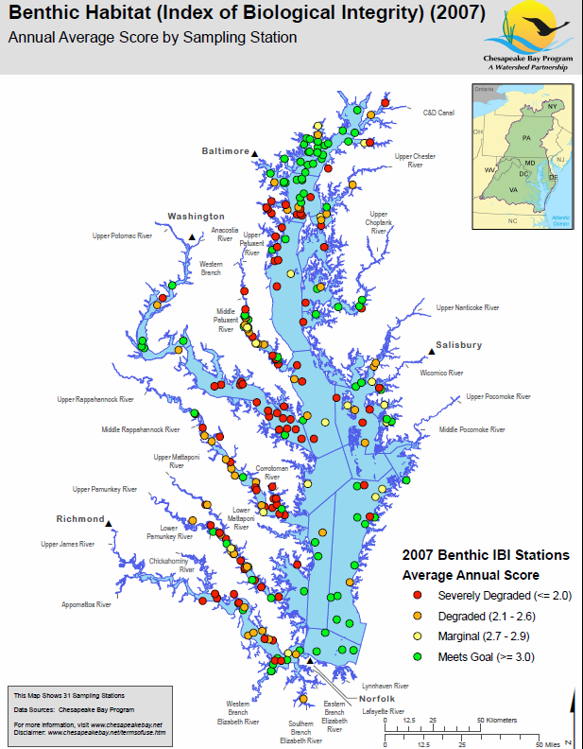
There is no predictive capability and little ability to overlay information
Because data collection efforts are fragmented it is hard to both visualize the data and access the data in a timely fashion.
Fixed data products are the only ones available
May not meet the users real needs
No capability to couple different types of data (weather, topography, land use, development).
No ability to test scenarios
For example: What is the effect on turbidity of the bay at a particular location after a particular amount of rainfall over a specific area?
GAIA is intended to bring together different existing pieces and provide the glue to put the puzzle together.

Slide 38
GAIA – “One stop shopping for Earth Science Knowledge and Information”
In the following slides the functional requirements of GAIA are described.
Analysts can be thought of as members of the basic and applied research community
Users are government and NGO policy makers as well as members of the research community.
GAIA enables the transition of models and information from research to operations.
GAIA enables decision making.
GAIA institutes 3 core elements:
A data access function – GAIA VxO
An interaction e-conferencing facility – e-GAIA
An interactive visualization library – GAIA ACTION

Slide 39
In the following figures the individual functions and responsibilities of the GAIA community members are described.
Data
Analyst
Results
The principal function of the scientific community is to take in data and produce a result.
This result may be a publication.
Often these results are not readily accessible or understood by policy/decision makers.

Slide 40
One of the challenges is that the data come from many sources, in many formats.
Data
Analyst
Results
Data
Data
Data
Data
Data
Data

Slide 41
One of the challenges is that the data come from many sources, in many formats.
Data
Analyst
Results
Semi- or Un-structured Data
Data
Linked Open Data
Data
_{RDBMS}
Cloud Data

Slide 42
GAIA will identify high value data for particular use cases and demonstrate the means to extract relevant data
Data
Analyst
Results
Semi- or Un-structured Data
_{Extractors}
Data
Linked Open Data
Ingesters
Data
_{RDBMS}
SQL
Cloud Data
Cloud Analytics

Slide 43
A “Virtual Observatory” at APL would capture the data access knowledge
Data
Virtual Observatory
_{Data}
Semi- or Un-structured Data
_{Extractors}
Data
Linked Open Data
Ingesters
Data
The virtual observatory knows where the data are and understands the format of those data.
The VxO extracts the relevant data from these sources and delivers them to the analyst.
_{RDBMS}
SQL
Cloud Data
Cloud Analytics
Notes:
Cloud computing is Internet- ("cloud-") based development and use of computer technology ("computing").^{[1]} In concept, it is a paradigm shift whereby details are abstracted from the users who no longer need knowledge of, expertise in, or control over the technology infrastructure "in the cloud" that supports them.^{[2]} It typically involves the provision of dynamicallyscalable and often virtualized resources as a service over the Internet.^{[3][4]}
According to the IEEE Computer Society ‘It is a paradigm in which information is permanently stored in servers on the Internet and cached temporarily on clients that include desktops, entertainment centers, table computers, notebooks, wall computers, handhelds, etc.’
Cloud computing is a general concept that incorporates software as a service, Web 2.0 and other recent, well-known technology trends, where the common theme is reliance on the Internet for satisfying the computing needs of the users. For example, Google Apps provides common business applications online that are accessed from a web browser, while the software and data are stored on the servers.”

Slide 44
Data Access Across VxOs
Analyst
One stop shopping through a simple interface
Virtual Observatory –
the glue that enables
connection to the data
Geophysical Data (topography, geology, land use, surface composition)
Model output and forecasts
Sensor(s) data
Experiment planning tools and coincidence calculators for space and aircraft
Sensor(s) information (incl. availability, location, band coverage, resolution, limiting sensitivity, accuracy)

Slide 45
GAIA also hosts tools for the analyst.
Data
Analyst
Results
We can’t anticipate all possible uses of the data.
GAIA will build an open architecture that enables analysts to access and visualize the data.
Users then contribute tools to a common open source library.

Slide 46
The Analyst uses tools and information from models to produce a result.
Data
Models
Results
Algorithms
Work Flow
Anomaly Identification
Feature Extraction

Slide 47
The Results are made available to Users and archived by GAIA – this feedback is essential to building knowledge
Data
Models
Results
Algorithms
Workflow
Anomaly Identification
Feature Extraction

Slide 48
Work flow – capturing the transformation of data into knowledge
Knowledge transfer as well as information content is the goal
Once a tool for producing a given data product has been created - how do you reproduce that?
“Workflow” means reproducing the process of achieving a given result:
What data were accessed?
What parameters were supplied?
How was the data processed?
Where are “golden data sets” produced with this flow?
A workflow can be passed on to a user - R2O
The user can then reproduce the processing of a highly skilled analyst.
The workflow can become an algorithm that supports a user directly.
Notes:
A workflow consists of a sequence of connected steps. It is a depiction of a sequence of operations, declared as work of a person, a group of persons,^{[1]} an organization of staff, or one or more simple or complex mechanisms. Workflow may be seen as any abstraction of real work, segregated in workshare, work split or other types of ordering. For control purposes, workflow may be a view on real work under a chosen aspect,^{[2]} thus serving as a virtual representation of actual work. The flow being described often refers to a document that is being transferred from one step to another.
A workflow is a model to represent real work for further assessment, e.g., for describing a reliably repeatable sequence of operations. More abstractly, a workflow is a pattern of activity enabled by a systematic organization of resources, defined roles and mass, energy and information flows, into a work process that can be documented and learned.^{[3][4]} Workflows are designed to achieve processing intents of some sort, such as physical transformation, service provision, orinformation processing.
Workflow concepts are closely related to other concepts used to describe organizational structure, such as silos, functions, teams, projects, policies and hierarchies. Workflows may be viewed as one primitive building block of organizations. The relationships among these concepts are described later in this entry.
The term workflow is used in computer programming to capture and develop human-to-machine interaction.

Slide 49
Analysts create results from the data and these results are made available to Users
Data
Analyst
Results

Slide 50
Users take the results and interact with them to create the knowledge required to make an informed decision
Results
Users
Inter-action

Slide 51
The User requires a set of tools to organize data and results
Maps
Results
Inter-action
Visualization
Timeline
iGoogle
Google
Alert
Search
IM
Entity Relationship
GAIA would provide the architecture for creating new tools – not all the tools.
GAIA would “seed” the process by creating an initial set of tools for a particular “use case”

Slide 52
GAIA would support electronic conferencing to promote the virtual interaction of the analyst and user communities
Analyst
Knowledge
_{Discovery}
_{Dissemination}
User
Notes:
Analysts and users can be the same at times… users are the end consumers of the production of knowledge about the system

Slide 53
The interaction with the analysts enables the user to address their individual requirements while also providing access to subject matter experts
Analyst
User
Observe
Integrate
Hypothesize
Test
Evaluate
Notes:
Analysts and users can be the same at times… users are the end consumers of the production of knowledge about the system

Slide 54
GAIA will support the feedback from the user to the analyst community
Adaptive Learning
Analyst
User
Bayesian Reasoning
Learning and Reasoning
Reasoning by Analogy
Reinforcement Learning
Evidence marshalling
Notes:
Analysts and users can be the same at times… users are the end consumers of the production of knowledge about the system
Model-driven
– Framework that supports probabilistic
integration of diverse data sources
– Define network dependencies and joint
probability distributions through knowledge
modeling
– Reasoning = update local variable distributions
or network structure with new data
Determine similarities related to network structure and
semantic concepts
– Reason related to similarities and differences
– Learning = store and retrieve closest analogs
Reinforcement learning
Agents use local strategies to choose actions
that optimize global utility functions
– Agents follow actions of other successful
agents
– Learning = learn best strategies and learn
network structure through user interactions

Slide 55
GAIA will support the interaction of the users with the results and provide feedback to the analyst on how well their results meet user needs.
Results
Users
Inter-action
Supported by e-GAIA

Slide 56
e-GAIA: bringing users and analysts together
e-GAIA provides an electronic conference facility
For the IRAD we will determine what the specific requirements would be to enable an e-conference on the focus problem and how that could be implemented.
Specific conferences would be held to address focus areas. For example, for a focus on the Chesapeake Bay:
Impact of global climate change on area economy
Long term planning
Impact of economic growth on ecosystem
Data infrastructure
registration
Data Access Tools
Visualization Tools
Focused tutorials
Conference resources
On Demand Models
Discussion and Synthesis
Virtual Sessions
Model library
Economy
Ecology
Global Impacts
Other topics

Slide 57
Outcomes of e-conferences will shape future activities
e-GAIA will provide the means:
for the participants to pose questions, form new ad hoc focus groups, propose new e-conferences
for the user community to assess the value of models and visualization tools
To focus efforts in a particular direction
To establish a (leadership) role for APL in Earth Sciences
To grow a vigorous Earth Science program

Slide 58
GAIA ACTION - Actionable Content & Timely Information On the Network
ACTION is an open source architecture for implementing access to information in a customizable user interface.
GAIA ACTION will develop a set of basic functions to demonstrate the utility of the interface
Typical modules will provide real-time access to news, databases, model runs, satellite data and monitoring stations
GAIA ACTION provides a cross-agency cross-disciplinary interface to resources that are already available
The information, models and tools are available.
GAIA ACTION takes advantage of the existing investment and leverages that to establish a new business area and to provide a nucleus for a future work
Notes:
http://155.206.18.162/mapping/map/map.phtml

Slide 59
Example Interface to Data, Models and Existing Data Display Tools

Slide 60
Example Interface to Data, Models and Existing Data Display Tools
GAIA Tools
Environmental signature data from remote stations
NOAA Data Tool
Google Maps
Trend and climatological data
Notes:
http://155.206.18.162/mapping/map/map.phtml
http://chesapeakebay.noaa.gov/esiatlassamplemd.aspx

Slide 61
Developing Infrastructure – Build, Buy or Modify
APL has a rudimentary infrastructure that can be pieced together to support collaboration: (http://workshops.jhuapl.edu, wikis, sharepoint, meetingplace, etc.) but they are not integrated.
Collaborative platforms which provide the means to share information:
Hubzero, Drupal, and Blackbook.
These are different than social networking tools like
Facebook, Googlewave, Linkedin, etc
To paraphrase George Orwell – “all users are created equal – some are more equal than others”
Blackbook supports tiered, secure access to data
For many users this will be an important factor in any collaborative environment
Supported by US National Intelligence Office
Blackbook wiki at http://blackbook.jhuapl.edu

Slide 62
Collaborative Platforms Must be Open Source
All three of these can provide a collaboration platform that we can use.
Hubzero and Drupal are more oriented toward the science community and benefit from scientific community involvement in developing extensions.
All of these are either open source or expected to be made open source.
All provide an API for extensions
Why do we want an open source solution?
Features need to be developed as the community evolves such as on-line data visualization, data quality, model quality, and subject matter expert evaluation.

Slide 63
The Geophysics Community can take Advantage of these Developments
HUBzero was created with NSF funding.
It provides a set of tools to run batch jobs (and graphical “workflows”) from remote users – this could be useful for extracting knowledge from VxOs and modelling centers.
Drupal is an international effort
There are also “workflow” extensions as in HUBzero.
Google Wave is still only in development, but it has the power of Google behind it.
Google already has many useful on-line tools, like Google docs, that allow people to collaboratively create and edit MS Office compatible documents through your web browser.
Google Wave also provides collaborative windows where people can type messages in different languages that are translated in realtime as you type!
Notes:
We need to be more closely coupled

Slide 64
GAIA will transform the use of climate knowledge
Data
Analyst
Action
Development can be facilitated with the creation of a Climate Knowledge Virtual Organization (GAIA)
The effort is enabled by concurrent efforts from other communities within and external to APL and the JHU community.

